Slide 1
Body Age Prediction from Body Features
Skylar Wurster

Slide 2
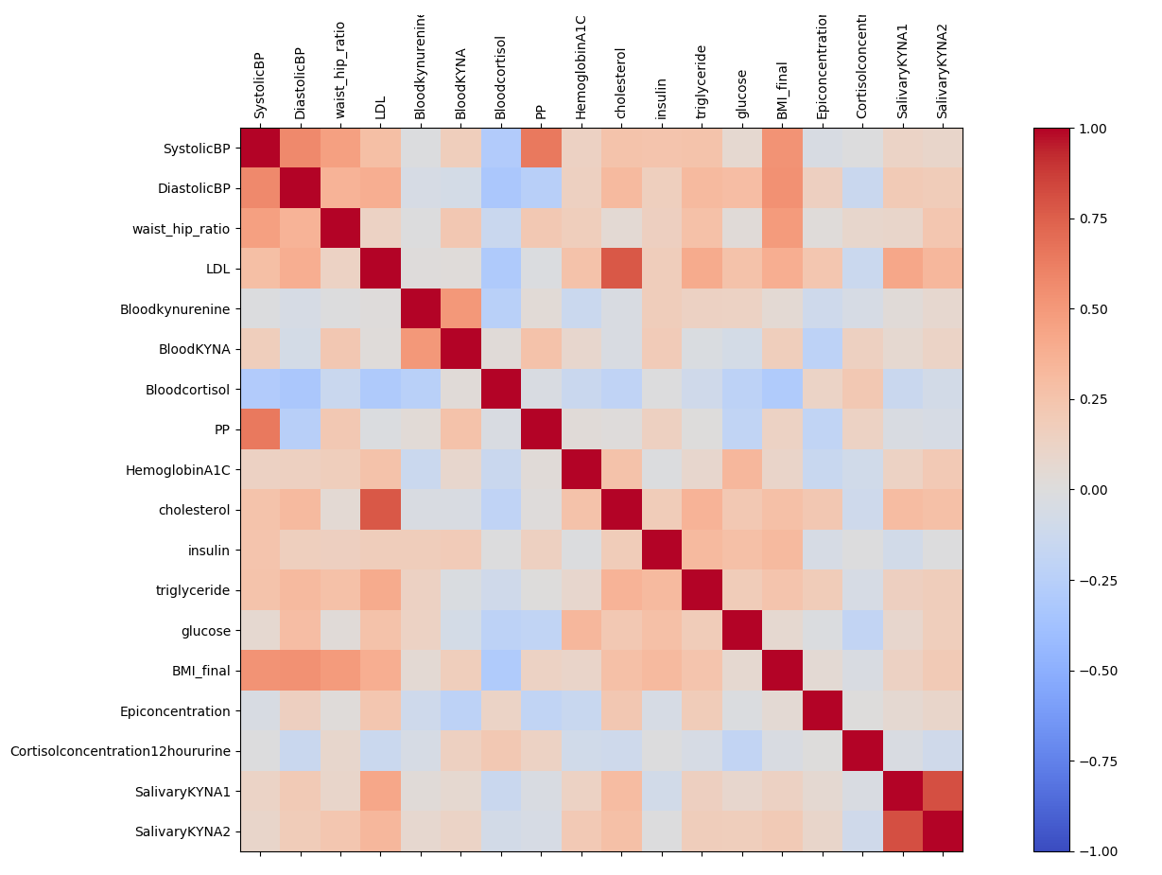
Multicollinearity

Slide 3
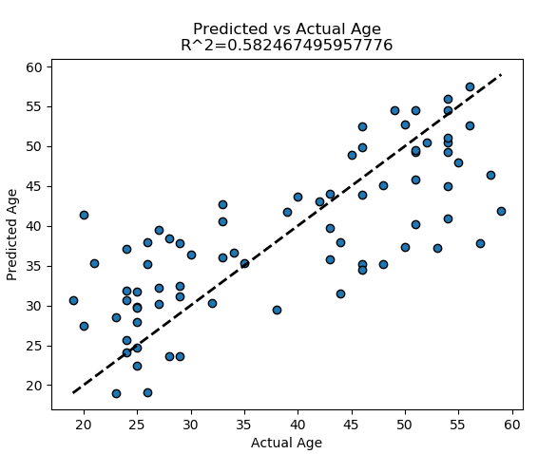

Age prediction – Linear Regression

Slide 4
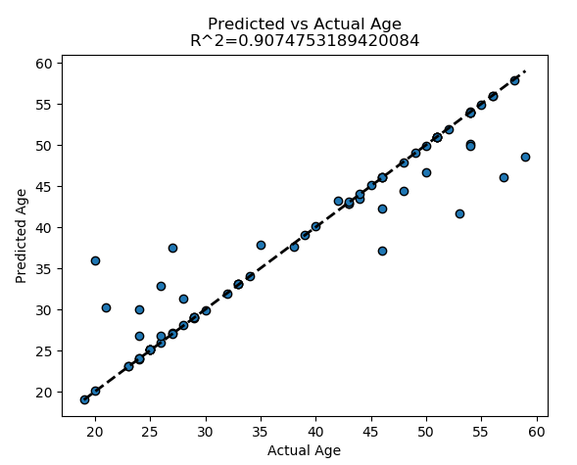

Age prediction – SVM with RBF kernel

Slide 5
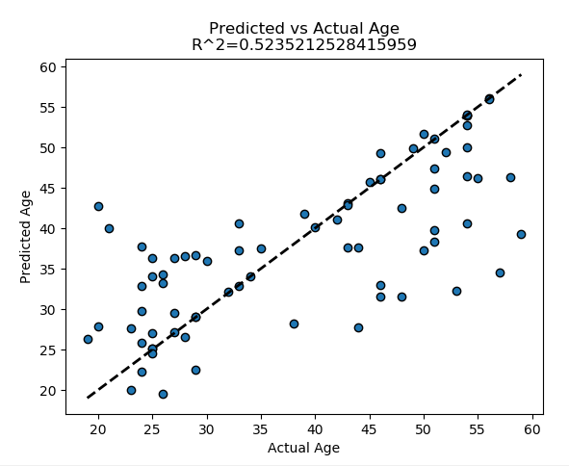

Age prediction – SVM linear

Slide 6
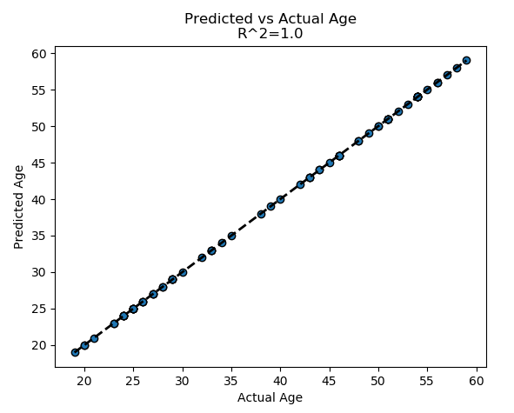

Age prediction – Decision Tree Regressor

Slide 7
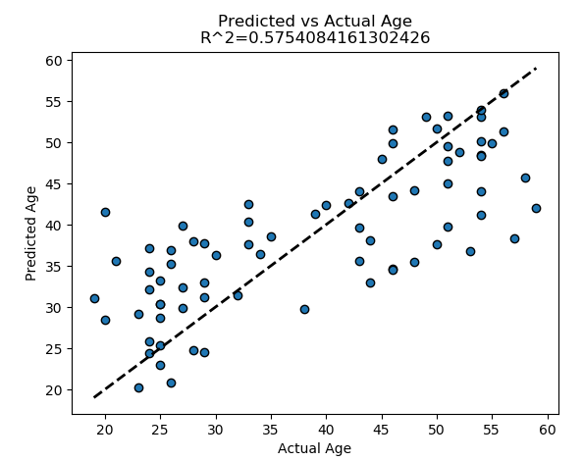

Age prediction – Ridge

Slide 8
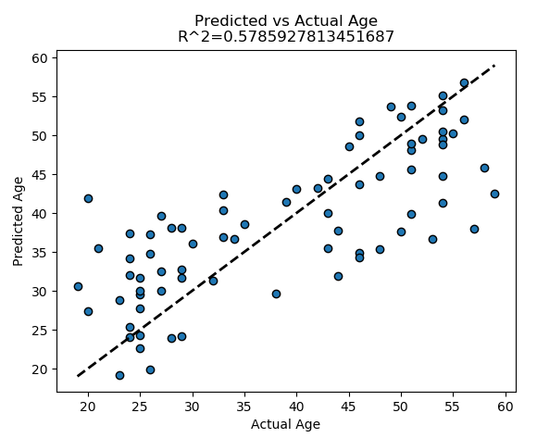

Age prediction – Lasso

Slide 9
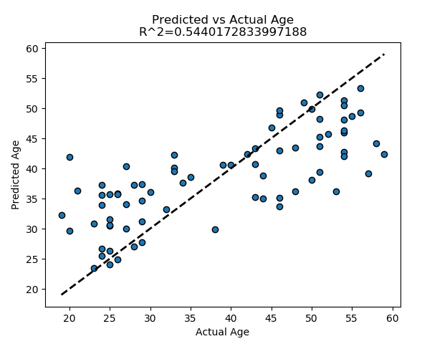

Age prediction – ElasticNet

Slide 10
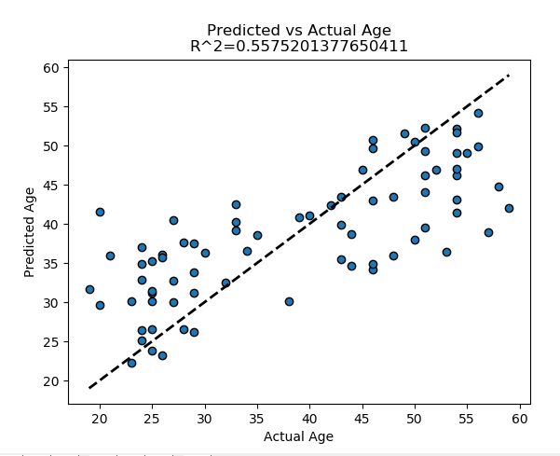

Age prediction – BayesianRidge

Slide 11
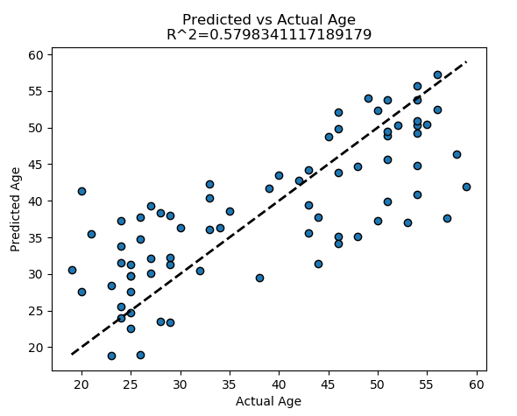

Age prediction – SGD Regressor

